Slide 1


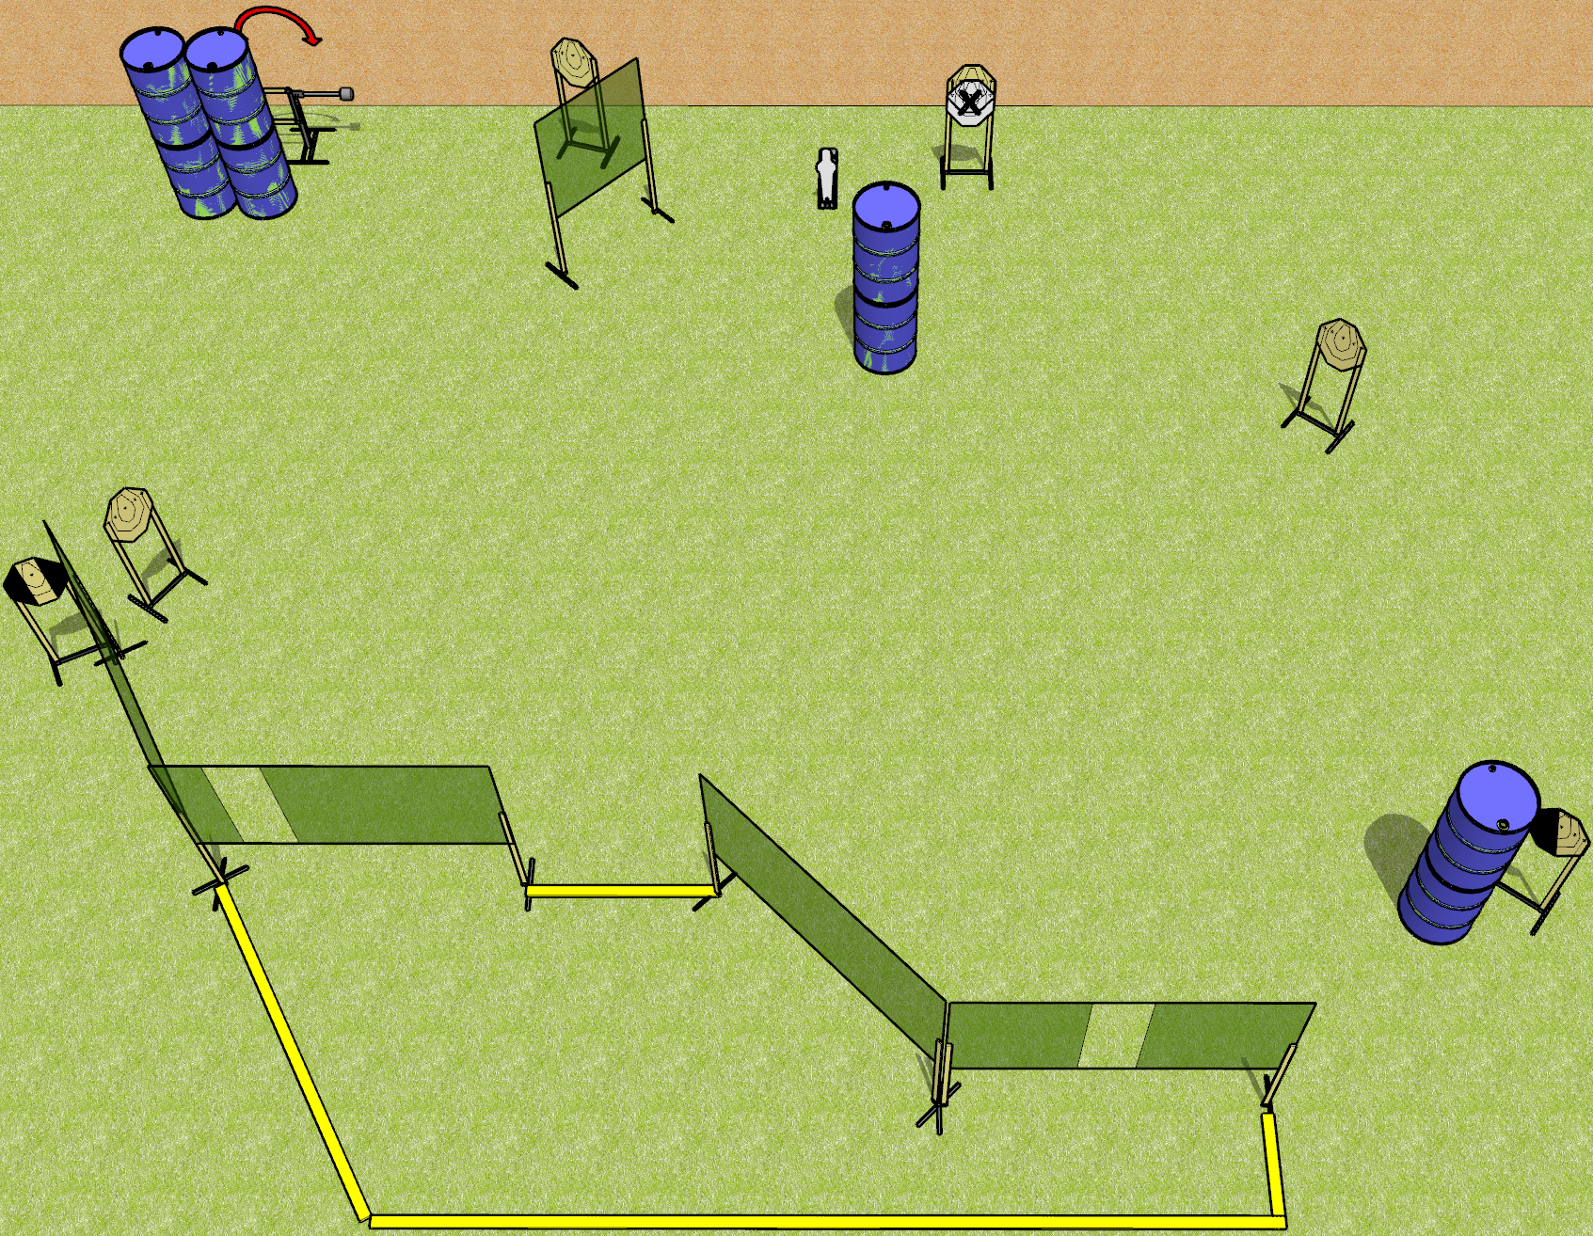
 | Dothan Gun Club – USPSA Match I Wish Course Designer : Drew Coleman
Round Count 15 rounds 7 IPSC 1 mini popper
Equipment List 10 wall feet 1 medium fault line, 1 3ft fault line Long fault lines should all be 10’ 1 tux, 1 left diagonal

Slide 2
I Wish
Written Stage Briefing
I Wish is a 15 round, 75 point, Comstock course of fire. There are 7 IPSC targets and 1 mini popper. The best 2 hits on paper will score, and steel must fall to score. The start signal is audible.
The swinger is activated by the mini popper and remains visible at rest.
Handgun start position is inside the shooting area, wrists below belt. Handgun is loaded and holstered.
PCC start position is inside the shooting area, stock on belt. Loaded carbine is held with both hands, safety on.
On start signal engage targets as they become available from within the shooting area.

